Slide 1
Discrete Distributions: (1) Uniform Distribution
Note: Uniform Distribution can also fall under continuous probability distributions category, depending on what we are measuring. If the observations are not discrete, a uniform distribution becomes continuous.
Uniform Discrete Distribution: Throw of a dice (exactly 1, 2, …, 6)
Uniform Continuous Distribution: Time taken by a flight (can go up to nano seconds and beyond)

Slide 2
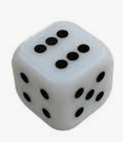
Uniform Distribution
Rolling a fair die has 6 discrete, equally probable outcomes
We can roll a 1 or 2, but not 1.5
The probabilities of each outcome are evenly distributed across the sample space

Slide 3
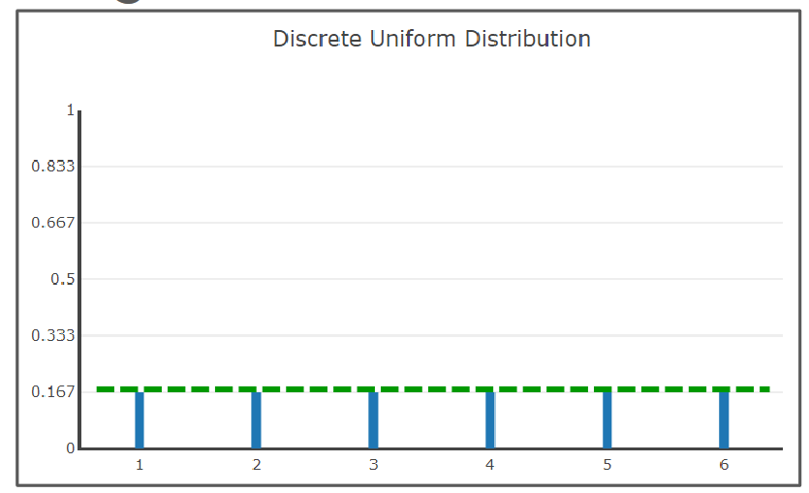
Uniform Distribution
Rolling a die has 6 equal probabilities and their total adds to 1
X-axis: Values
Y-axis: Probabilities

Slide 4
C:\code\Data Analytics\uniform_dist.py
import numpy as np
import matplotlib.pyplot as plt
values = np.random.uniform(-10.0, 10.0, 100000)
plt.hist(values, 50)
plt.show()

Slide 5
Discrete Distributions: (2) Binomial Distribution

Slide 6
Binomial Distribution
“Bi” means two, so a binomial variable is a variable that can take on exactly two values
The two outcomes are mutually exclusive
Example: Heads or Tails, On or Off, Sick or Healthy, etc
The two outcomes that the binomial random variable can take do not always have to be equally probable
Example: In a fruit basket, there are 7 apples and 3 oranges
P(A) = 7/10, P(O) = 3/10
A binomial distribution is a Bernoulli Trial, a random experiment in which there are only two outcomes – success or failure

Slide 7
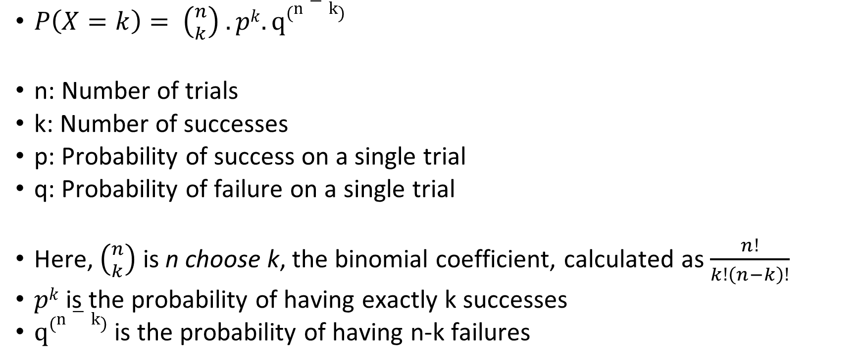
Binomial Probability Mass Function
$P\left(X=k\right)= \left({n \atop k}\right) .pk. q\left(n−k\right)$
n: Number of trials
k: Number of successes
p: Probability of success on a single trial
q: Probability of failure on a single trial
Here, $\left({n \atop k}\right)$ is n choose k, the binomial coefficient, calculated as $\frac{n!}{k!\left(n−k\right)!}$
$pk$ is the probability of having exactly k successes
$q\left(n−k\right)$ is the probability of having n-k failures

Slide 8
Example
Suppose a factory produces light bulbs, and historically, 5% of the bulbs are defective. The quality control team randomly selects 10 bulbs for testing. What is the probability that exactly 2 of them are defective?
n = Number of bulbs tested = 10
k = Number of defective bulbs = 2
p = Probability that a bulb is defective = 0.05
q = 1 – p = 0.95 = Probability that a bulb is not defective

Slide 9
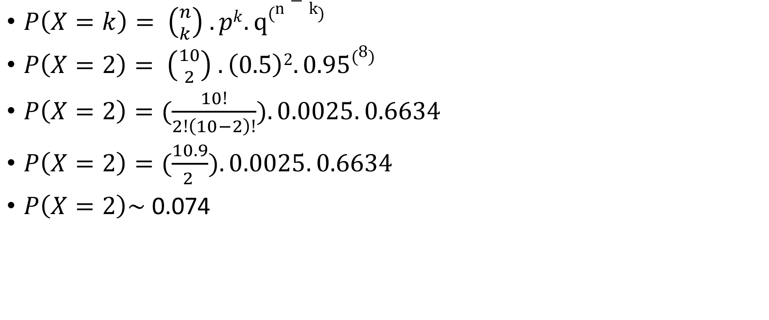
Solution
$P\left(X=k\right)= \left({n \atop k}\right) .pk. q\left(n−k\right)$
$P\left(X=2\right)= \left({10 \atop 2}\right) .\left(0.5\right)2. 0.95\left(8\right)$
$P\left(X=2\right)=(\frac{10!}{2!\left(10−2\right)!}).0.0025. 0.6634$
$P\left(X=2\right)=(\frac{10.9}{2 }).0.0025. 0.6634$
$P\left(X=2\right)\sim$ 0.074

Slide 10
Python Example
binomial_distribution.py in C:\code\Data Analytics

Slide 11
Discrete Distributions: (3) Poisson Distribution

Slide 12
Poisson Distribution
Binomial distribution considers the number of successes in n trials
Poisson distribution considers the number of successes per unit of time (or another continuous unit, such as distance)
Example: Suppose on an average there are 10 births in a hospital every hour. What is the probability that >12, <5 or 8-11 births will happen in the next hour?

Slide 13
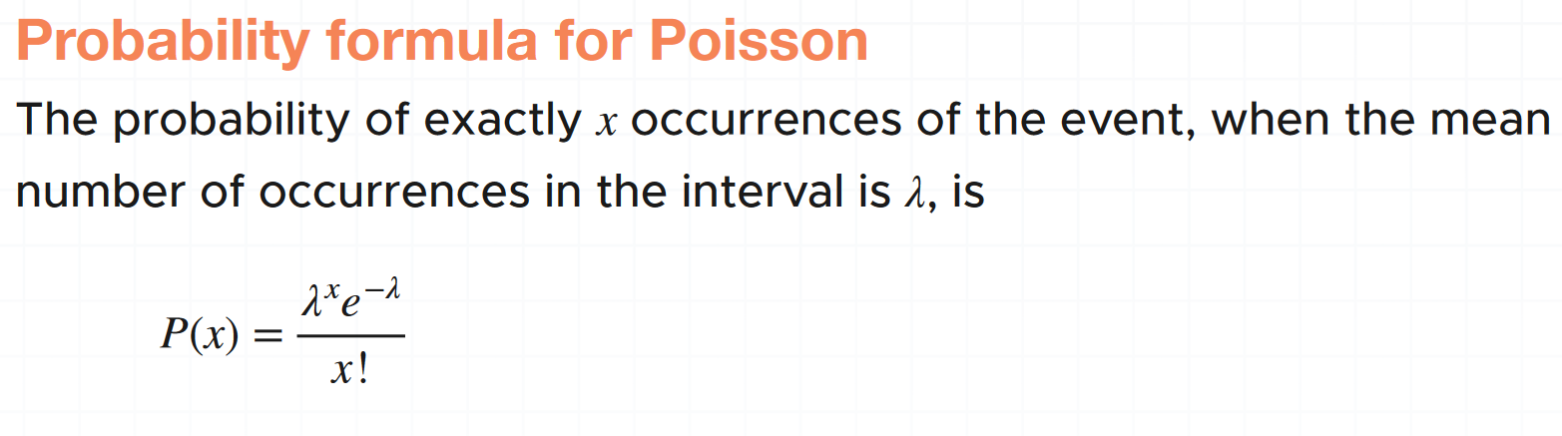
Poisson Distribution – Example
Let’s say we want to use a Poisson process to model the number of cars that pass through an intersection each hour. Suppose we believe that the mean number for this is 15 cars in an hour. Now we want to know the probability that 13 cars will pass through in the next hour.
The e in the Poisson distribution formula stands for the number 2.718. This number is called Euler's constant. You can simply substitute e with 2.718 when you're calculating a Poisson probability.

Slide 14
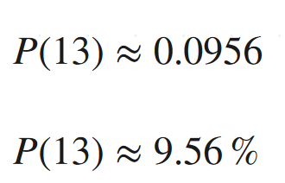
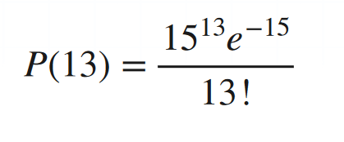
Poisson Distribution – Example
Let us apply the formula
So there’s an approximately 9.56 % chance that 13 cars will pass through the intersection in the next hour.

Slide 15
Poisson Distribution – Another Example
A food delivery joint typically receives 8 deliveries between 4 and 5 pm on Fridays. What is the probability that only 4 deliveries will be received coming Friday?

Slide 16
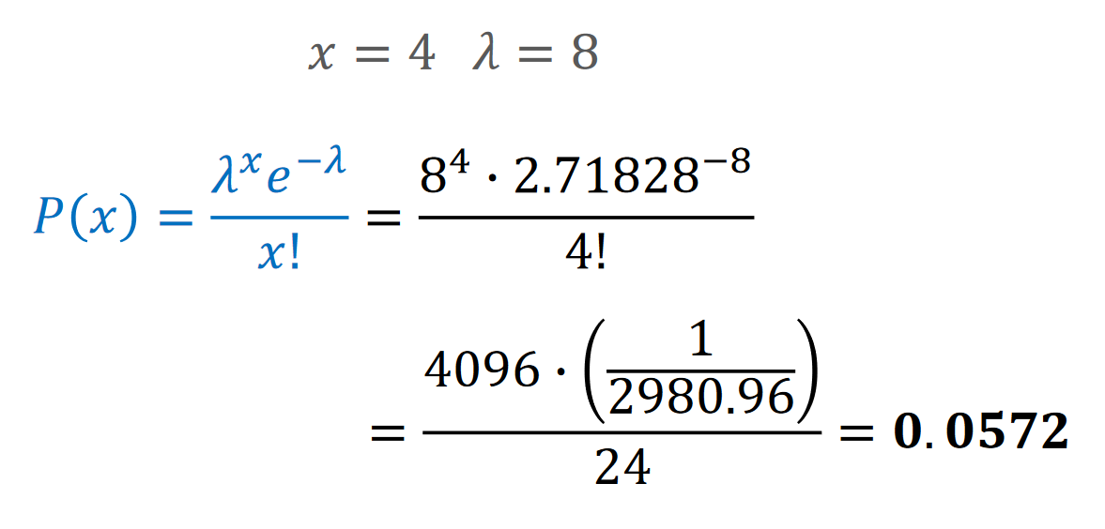
Poisson Distribution – Another Example
A food delivery joint typically receives 8 orders between 4 and 5 pm on Fridays. What is the probability that only 4 orders will be received coming Friday?

Slide 17
Poisson Distribution – Code
poisson_distribution.py in C:\code\Data Analytics

Slide 18
Continuous Distributions: Normal Distribution

Slide 19
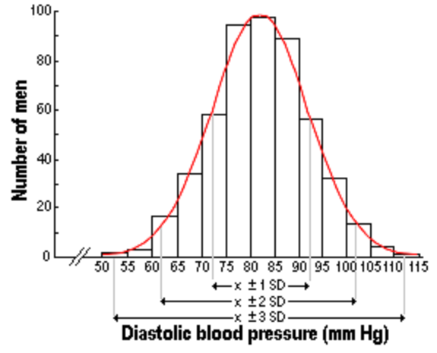
Real life and Normal Distribution
Many real-life data points follow Normal Distribution:
People’s heights and weights
Population blood pressure
Test scores
Also called as Gaussian Distribution
Generally, less/non-natural phenomena do not have normal distributions, e.g. income of people

Slide 20
Normal Distribution, Bell Curve …
In the US, a baby is just born with weight of 2.91 kg
The mother is told that the baby’s weight is below average and hence she is concerned
Is the weight unusually low?
We can use the population distribution, which is the pattern of all the babies born in a particular year in the US
We can then compare the weight of the newly born baby to see whether it is low, and if yes, by how much?

Slide 21
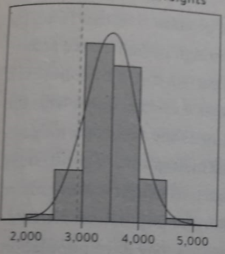
Distribution of over 1 Million Babies’ Birth Weights
X-axis denotes the weight in grams
The current baby’s weight is the dotted line
Its position in the distribution can be used to assess whether it is unusual
The shape of this distribution is important – called normal distribution or bell curve

Slide 22
Characteristics of Normal Distribution
Uses only two things: Mean and Standard deviation
In our example, the mean is 3480 grams and standard deviation is 462 grams
How can we use this information?

Slide 23
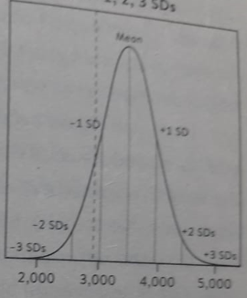
Use of Mean and Standard Deviation
Now we see the position of the mean and 1, 2, and 3 standard deviations each side of the mean
From the mathematical properties of the normal distribution, roughly 95% population will be within mean ± two SDs and 99.8% within mean ± three SDs
The new baby is 1.2 SDs below mean (why? See next slide), which is her Z-score (which measures how many SDs away a data point from the mean)

Slide 24
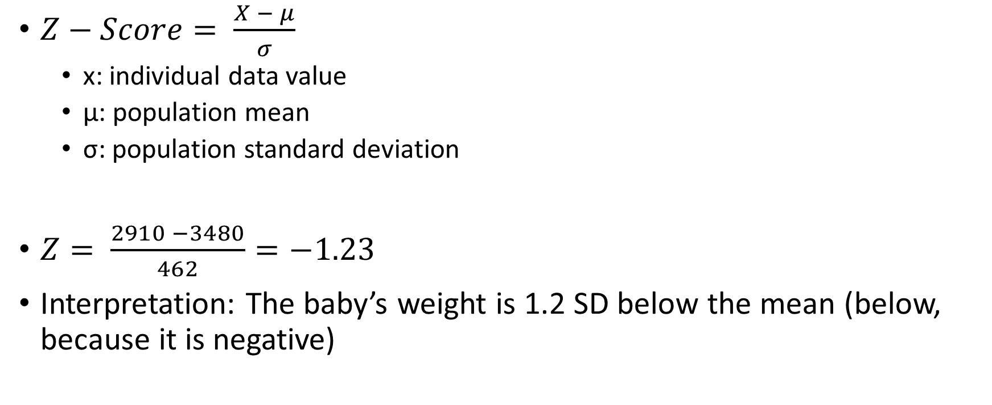
Why is the Baby 1.2 SD below the Mean?
$Z−Score= \frac{X − μ}{σ}$
x: individual data value
μ: population mean
σ: population standard deviation
$Z= \frac{2910 −3480}{462}=−1.23$
Interpretation: The baby’s weight is 1.2 SD below the mean (below, because it is negative)

Slide 25
Shapiro Test (C:\code\Data Analytics\normal-distribution-shapiro.py)
Shapiro-Wilk Test tells if our data sample comes from a normally distributed population
It arranges all data points in an ascending order and subtracts mean from each data point
Then it divides the data by standard deviation
This transforms the data to a standard normal distribution with a mean of 0 and standard deviation of 1
It then looks at the various quantiles (e.g. Q1, Q2, Q3) of the data and compares them with the expected values for normal distribution
It then uses the p-value (discussed separately) to make a conclusion

Slide 26
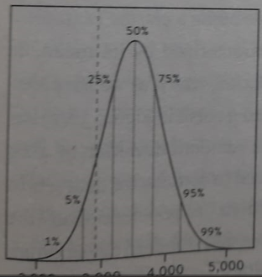
Percentiles and Quartiles
Percentile: That percentage of data is less than the point at which we are
The 50th percentile is the median – the weight of the average baby
The 25th percentile (3167 grams) is the weight under which 25% of the babies lie ~ Quartile 1
The 75th percentile (3791 grams) is the weight under which 75% of the babies lie ~ Quartile 3
Inter Quartile Range (IQR) = 3791 – 3167 = 624 grams

Slide 27
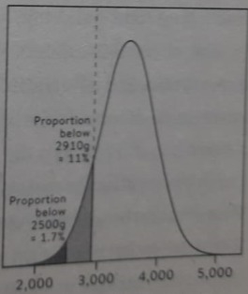
Interpreting the new baby’s weight
The new baby’s weight lies on the 11th percentile (Why? See next slide)
This means that 10% babies born had weight lesser than her

Slide 28
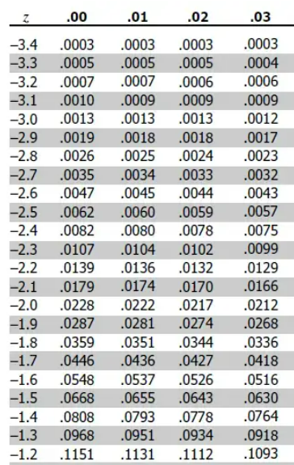
Using Z-Score
We know the Z-score for the current baby: -1.23
Go to Z-table (https://www.z-table.com/)
Look for -1.2 in row and 3 in column
Interpretation: ~10% babies have lesser weight
So, this baby is in the 11th percentile

Slide 29
Normal Distributions and Empirical Rule
Normal distributions follow the empirical rule, also called the 68-95-99.7 rule
The rule tells us that, for a normal distribution, there’s a
68% chance that a data point falls within 1 standard deviation of the mean
95% chance that a data point falls within 2 standard deviations of the mean
99.7% chance that a data point falls within 3 standard deviations of the mean

Slide 30
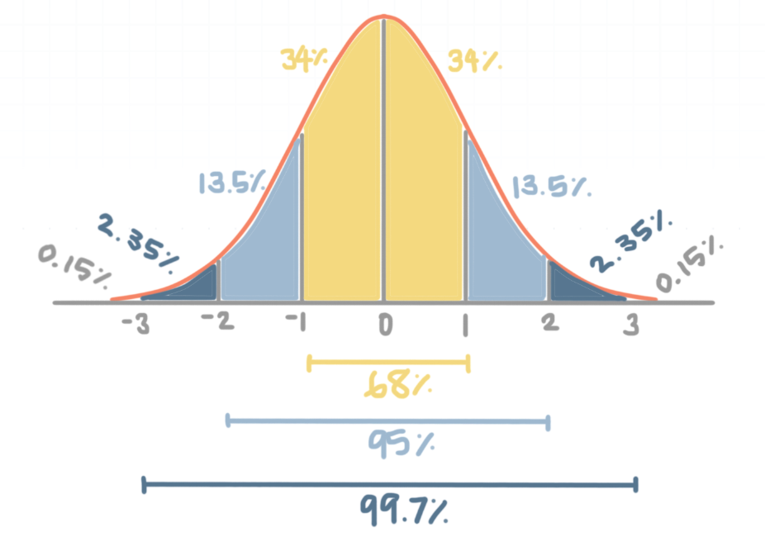
Use of this rule

Slide 31
Example
For CDAC C-CAT (300 marks test), the population average score 𝜇 is 170 and standard deviation is 𝜎 = 30.
A student has got 250 marks
Which minimum percentile is she in?
Mean = 170
SD = 30
Mean + 2 SD = 170 + 60 = 230 (95% of the population)
Mean + 3 SD = 170 + 90 = 260 (99.7% of the population)
So, the student is between 95th and 99.7th percentile
She is definitely in the top 5%, and close to top 1%

Slide 32
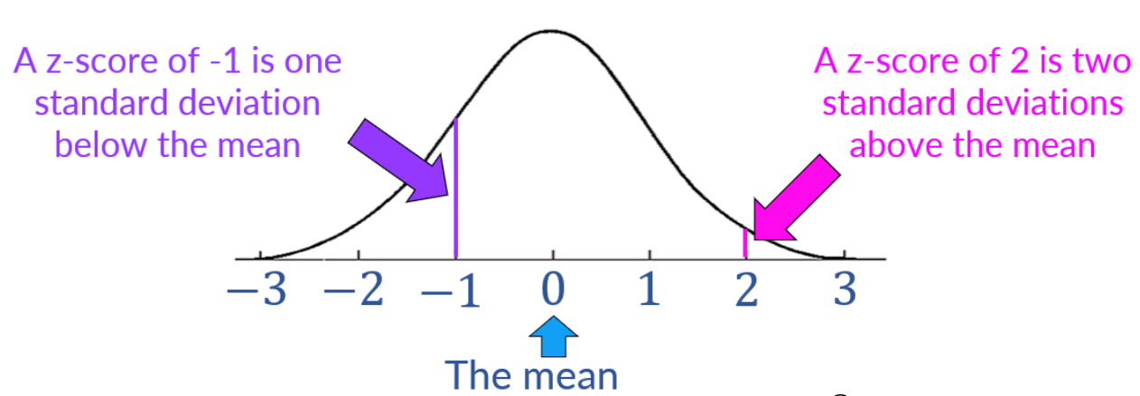
Z-Score
Z-scores > +3 and < -3 are considered outliers
The Z-Score describes how many standard deviations away a data point is from the mean

Slide 33


Z-Score Example
A runner participated in a 200m race and a 500m race
Consider the following and determine where she did better
Race | Average time | Standard deviation | Runner’s time
200m | 31s | 1.5s | 28s
500m | 125s | 8.2s | 132s
200m
$$Z= \frac{X − μ}{σ}=\frac{28 −31}{1.5}=−2$$
500m
$$Z= \frac{X − μ}{σ}=\frac{132 −125}{8.2.}=0.854$$

Slide 34
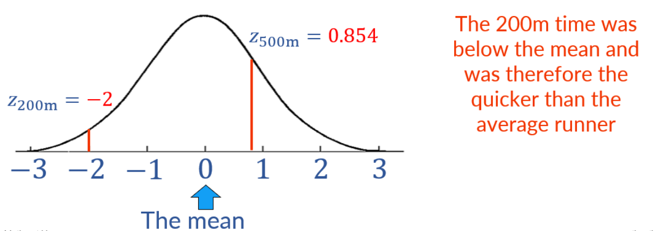
Visualizing Z-Scores
In other examples, positive/higher Z-score will be better, e.g. marks obtained by a student – Because, here the student would want to be above average
In this example, a lower time would be preferable when completing a race and so, the lower z-score would be better

Slide 35
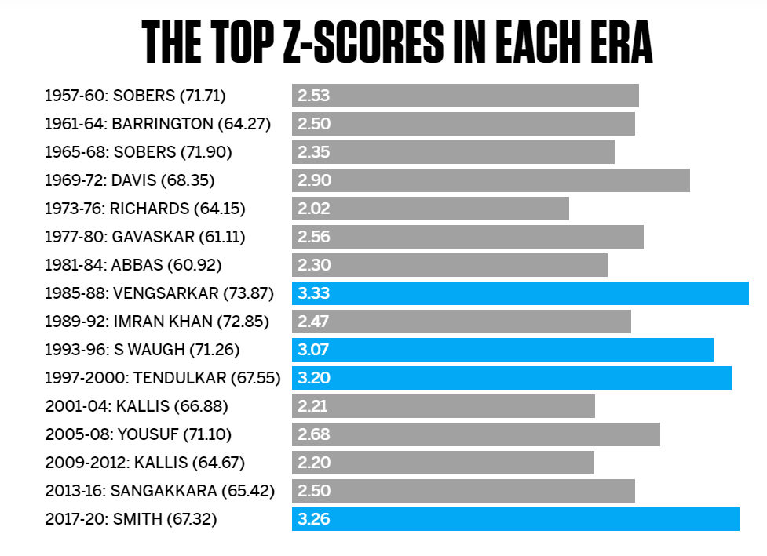
Z-Score Example

Slide 36
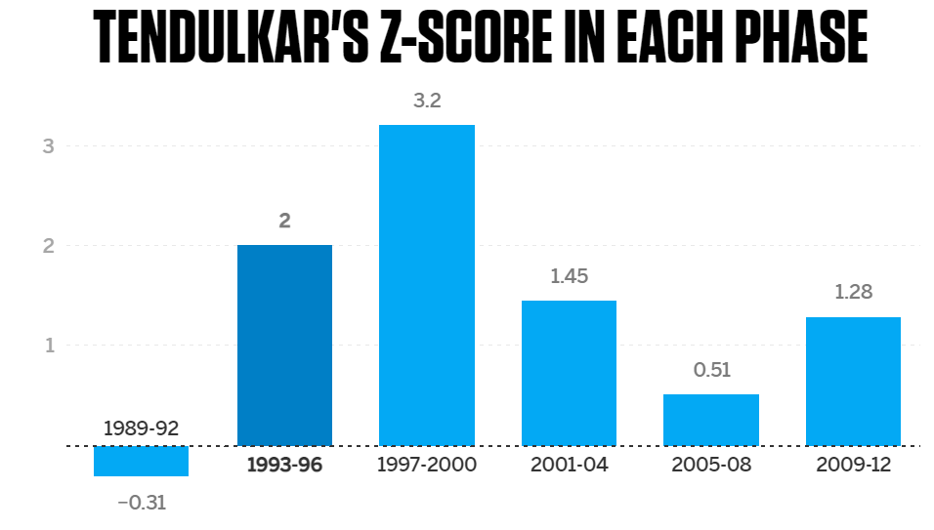
Z-Score Example

Slide 37
Usefulness of Z-Scores
Z-scores give us an idea of how an individual value compares to the rest of a distribution
Example: Is an exam score of 87 good?
If the exam scores for the whole population are normally distributed with a mean of 90 and a standard deviation of 4, we would calculate the z-score for 87 as:
z = (X – μ) / σ = (87 – 90) /4 = -0.75
Since this value is negative, it tells us that an exam score of 87 is actually below the average exam score for the population
An exam score of 87 is 0.75 standard deviations below the mean

Slide 38
Using Z-Table
The z-table provides the cumulative probability of a test value below or above a specific z-score
Suppose you have student marks following normal distribution with mean = 75 and SD = 10
# | Situation | Important points | Z-Score | Action
1 | Find the probability that a randomly selected student scored < 80 marks | Test value > mean (80 > 75) We are testing Test value < something | Positive | None
2 | Find the probability that a randomly selected student scored < 50 marks | Test value < mean (50 < 75) We are testing Test value < something | Negative | None
3 | Find the probability that a randomly selected student scored > 80 marks | Test value > mean (80 > 75) We are testing Test value > something | Positive | 1 – Result
4 | Find the probability that a randomly selected student scored > 45 marks | Test value < mean (45 < 75) We are testing Test value > something | Negative | 1 - Result
Why 1 – Result in the last two cases? Because Z-table gives cumulative probability that a random variable is <= a given Z-score. So, if we are looking for a random variable that is > a given Z-score, we need to subtract the resulting probability from 1

Slide 39
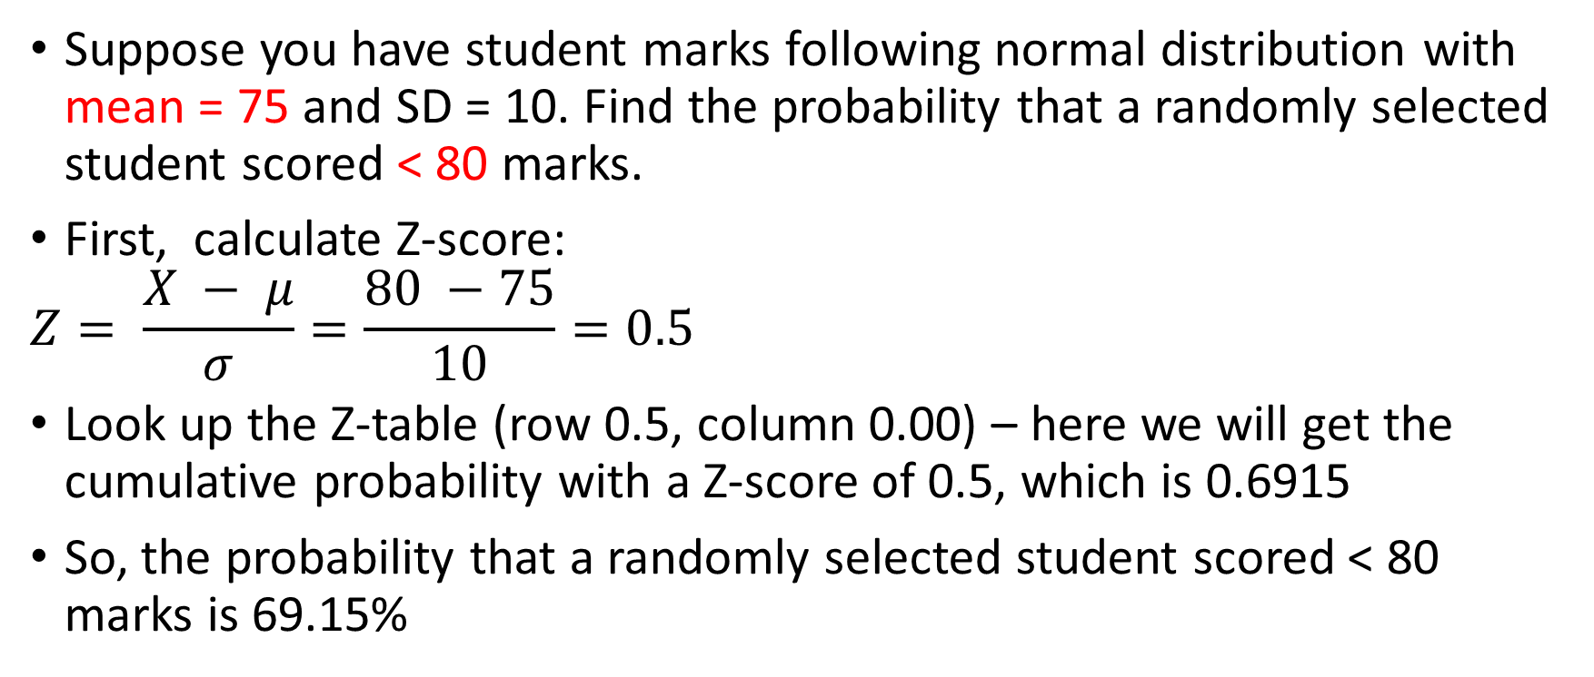
Z Table: Case 1
Suppose you have student marks following normal distribution with mean = 75 and SD = 10. Find the probability that a randomly selected student scored < 80 marks.
First, calculate Z-score:
$$Z= \frac{X − μ}{σ}=\frac{80 −75}{10}=0.5$$
Look up the Z-table (row 0.5, column 0.00) – here we will get the cumulative probability with a Z-score of 0.5, which is 0.6915
So, the probability that a randomly selected student scored < 80 marks is 69.15%

Slide 40
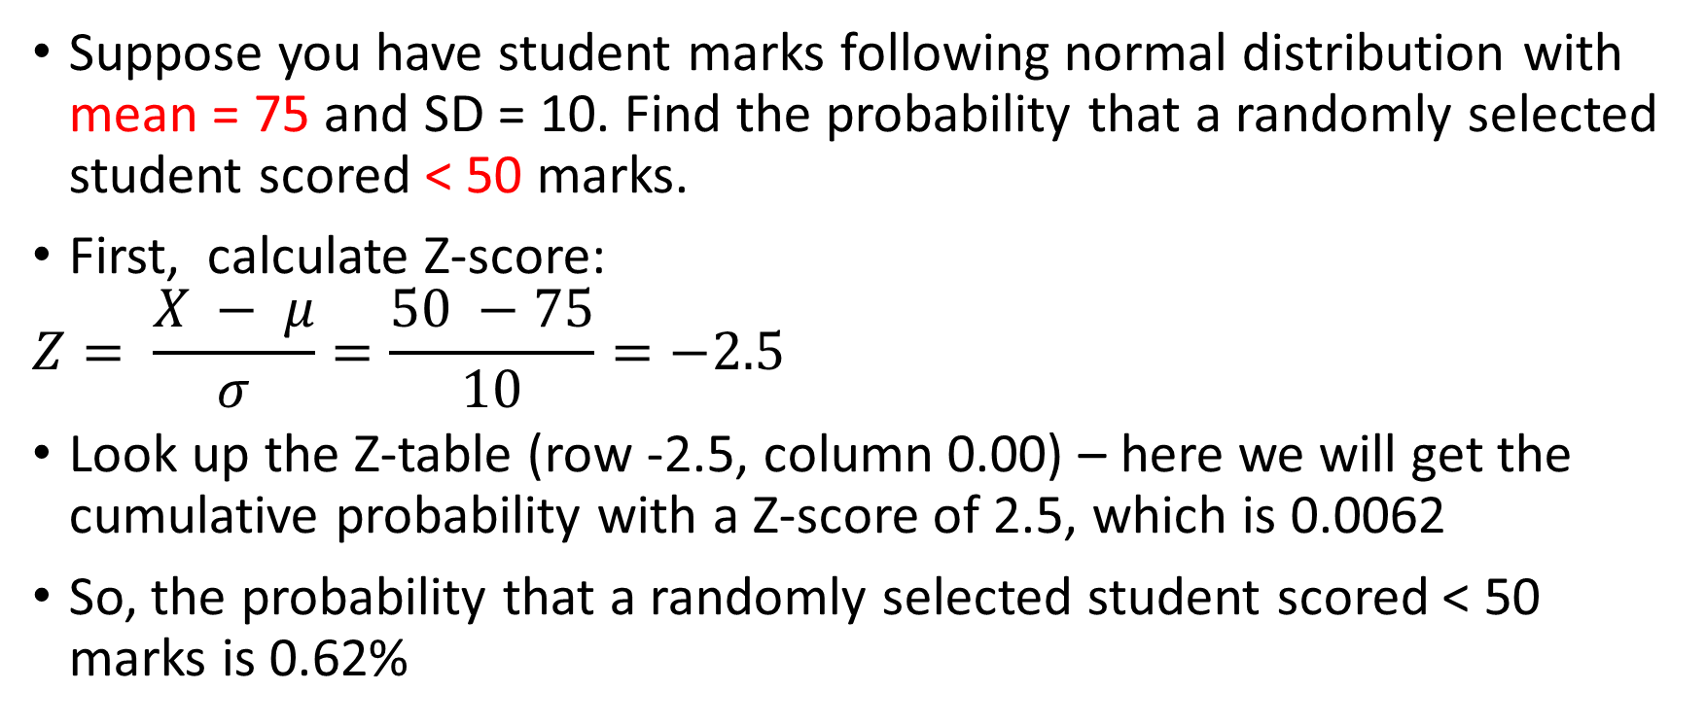
Z-table: Case 2
Suppose you have student marks following normal distribution with mean = 75 and SD = 10. Find the probability that a randomly selected student scored < 50 marks.
First, calculate Z-score:
$$Z= \frac{X − μ}{σ}=\frac{50 −75}{10}=−2.5$$
Look up the Z-table (row -2.5, column 0.00) – here we will get the cumulative probability with a Z-score of 2.5, which is 0.0062
So, the probability that a randomly selected student scored < 50 marks is 0.62%

Slide 41
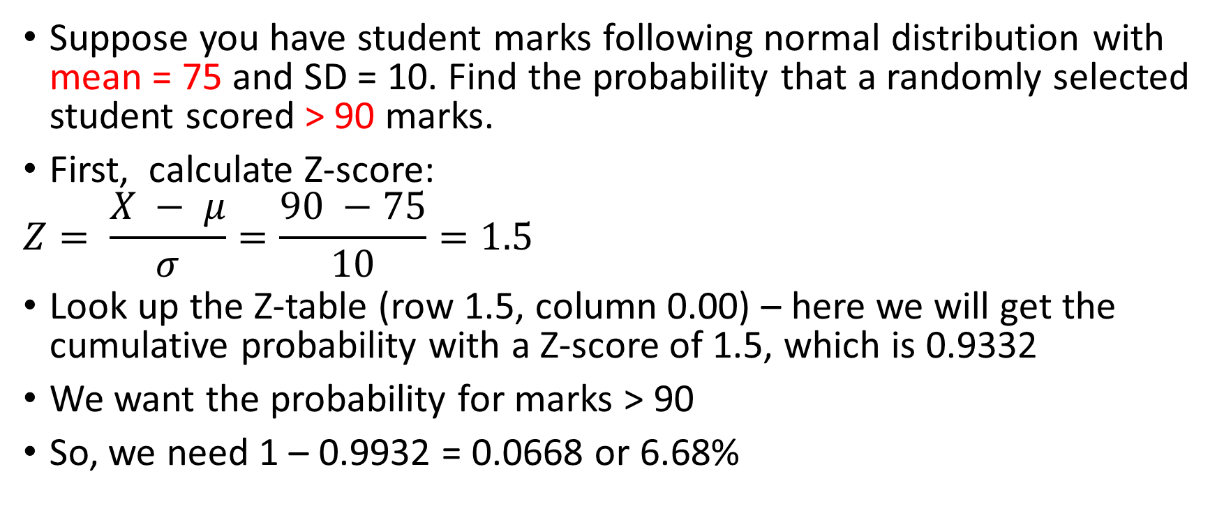
Z-table: Case 3
Suppose you have student marks following normal distribution with mean = 75 and SD = 10. Find the probability that a randomly selected student scored > 90 marks.
First, calculate Z-score:
$$Z= \frac{X − μ}{σ}=\frac{90 −75}{10}=1.5$$
Look up the Z-table (row 1.5, column 0.00) – here we will get the cumulative probability with a Z-score of 1.5, which is 0.9332
We want the probability for marks > 90
So, we need 1 – 0.9932 = 0.0668 or 6.68%

Slide 42
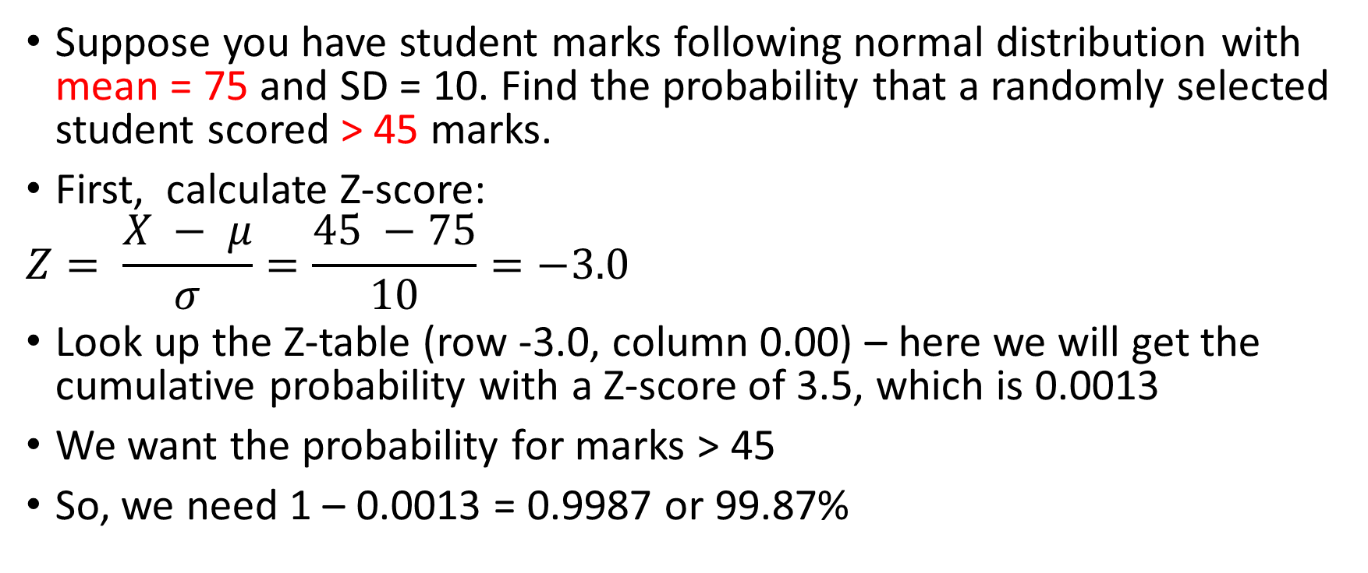
Z-table: Case 4
Suppose you have student marks following normal distribution with mean = 75 and SD = 10. Find the probability that a randomly selected student scored > 45 marks.
First, calculate Z-score:
$$Z= \frac{X − μ}{σ}=\frac{45 −75}{10}=−3.0$$
Look up the Z-table (row -3.0, column 0.00) – here we will get the cumulative probability with a Z-score of 3.5, which is 0.0013
We want the probability for marks > 45
So, we need 1 – 0.0013 = 0.9987 or 99.87%

Slide 43
Using Z-Score for Outlier Detection
C:\code\Data Analytics\implementation\normal_distribution.py
z_score_outlier.py in C:\code\Data Analytics

Slide 44
Sampling and Estimation

Slide 45
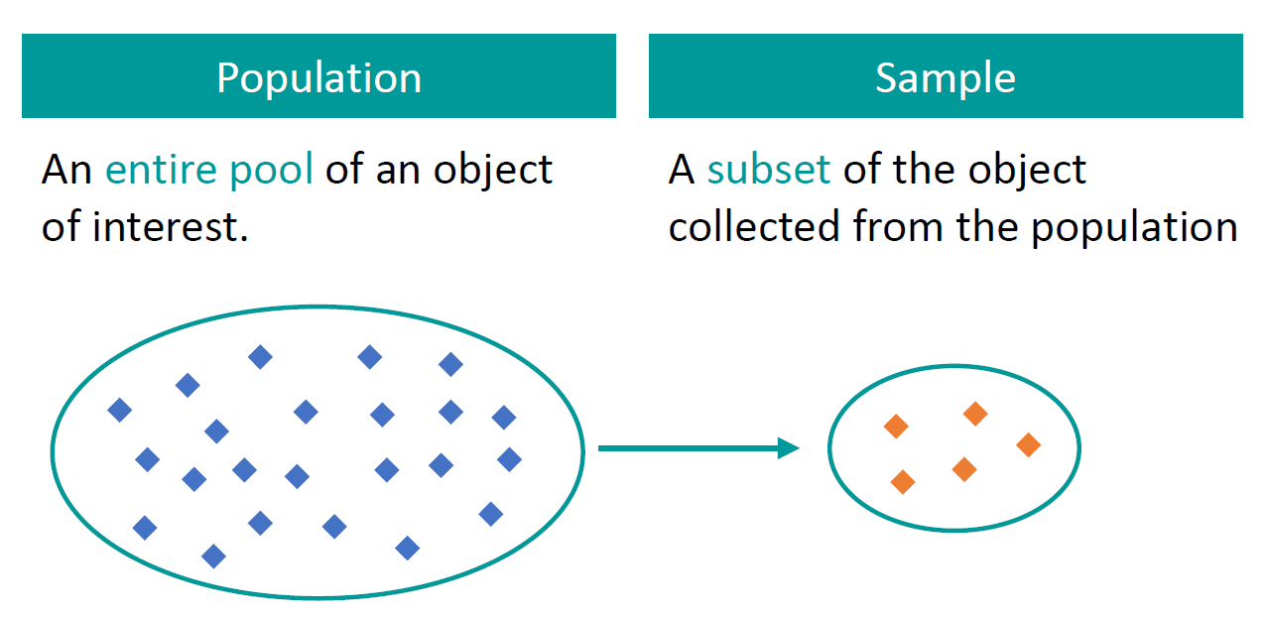
Sampling and Population
Population (N) = Entire group of subjects we are interested in
Sample (n) = A smaller group within the larger population

Slide 46
Sampling Techniques
Probability sampling involves random selection
Every member of the population has a chance of being selected
Mainly used in quantitative research
Most appropriate
Non-probability sampling involves non-random selection
Not every individual has a chance of being included
Easier and cheaper to access, but it has a higher risk of sampling bias
Used in qualitative research

Slide 47
Probability Sampling
Simple random sampling
Systematic sampling
Stratified sampling
Cluster sampling

Slide 48
Simple Random Sampling
In a simple random sample, every member of the population has an equal chance of being selected
Tools like random number generators are used
Example: To select a simple random sample of 100 employees of a company, we can assign a number to every employee in the company database from 1 to 1000, and use a random number generator to select 100 numbers

Slide 49
Systematic Sampling
Systematic sampling is similar to simple random sampling, but it is easier to conduct
Instead of randomly generating numbers, individuals are chosen at regular intervals
Example: All employees of the company are listed in alphabetical order and we select employee numbers 6, 16, 26, 36, …, so that we have 100 samples

Slide 50
Stratified Sampling
Stratified sampling divides the population into subpopulations (strata) based on the relevant characteristic (e.g. gender, age range, income bracket, job role)
Random or systematic sampling is used to select a proportionate sample from each subgroup
Example: If a company has 800 female employees and 200 male employees, we may select 80 women and 20 men

Slide 51
Cluster Sampling
Cluster sampling also divides the population into subgroups, but of sampling individuals from each subgroup, we randomly select entire subgroups
Good for dealing with large and dispersed populations, but there is more risk of error in the sample
Example: A company has offices in 10 cities across the country, so we randomly select 3 offices – these are our clusters

Slide 52
Non-Probability Sampling
Convenience sampling
Voluntary response sampling
Purposive sampling
Snowball sampling

Slide 53
Convenience Sampling
A convenience sample simply includes the individuals who happen to be most accessible to the researcher
Easy and inexpensive
May not guarantee sufficient coverage, different parts of the population
Example: To research opinions about student support services in our university, we ask your fellow students to complete a survey on the topic

Slide 54
Voluntary Response Sampling
A voluntary response sample is mainly based on ease of access
Instead of the researcher choosing participants and directly contacting them, people volunteer themselves (e.g. by responding to a public online survey)
Always at least somewhat biased, as some people will inherently be more likely to volunteer than others
Example: Generally people who respond to surveys are more likely to be those who have strong opinions about the topic

Slide 55
Purposive Sampling
In purposive sampling, also known as judgement sampling, the researchers use their expertise to select a sample that is most useful to the purposes of the research
Often used in qualitative research, where the researcher wants to gain detailed knowledge about a specific phenomenon rather than make statistical inferences
Example: We want to know more about the opinions and experiences of foreign students at our university, so we purposefully select a number of students from different countries in order to gather a varied range of data on their experiences with student services

Slide 56
Snowball Sampling
If the population is hard to access, snowball sampling can be used to recruit participants via other participants
The number of people we have access to “snowballs” as we get in contact with more people
Example: We are researching experiences of homelessness in your city and we meet one person who agrees to participate in the research – That person puts us in contact with other homeless people in the area

Slide 57
Unbalanced Data
We have unbalanced data when there is a large discrepancy between positive and negative cases
Example: Fraud is rare and most rows in the dataset will be ‘No fraud’
Solutions:
Oversampling: Randomly duplicate samples from the minority class to increase the size of the minority class
Undersampling: Randomly remove samples from the majority class – Usually not recommended
SMOTE (Synthetic Minority Oversampling Technique): Artificially generate new samples of the minority class using nearest neighbors
Run K-nearest-neighbors of each sample in the minority class
Create a sample from the KNN result (mean of the neighbors)

Slide 58
Hands-On
C:\code\Data Analytics\smote.py

Slide 59
The Central Limit Theorem (CLT)

Slide 60
Central Limit Theorem (CLT)
From a population, we draw samples
Example: From 1 lakh purchase transactions, we randomly select groups of 1000 transactions each
For each sample, suppose we calculate average order amount (called sample mean)
Now if we plot these sample means for a sufficient number of samples, these sample means would form a normal distribution (See next slide)
This is called as the Central Limit Theorem (CLT)

Slide 61
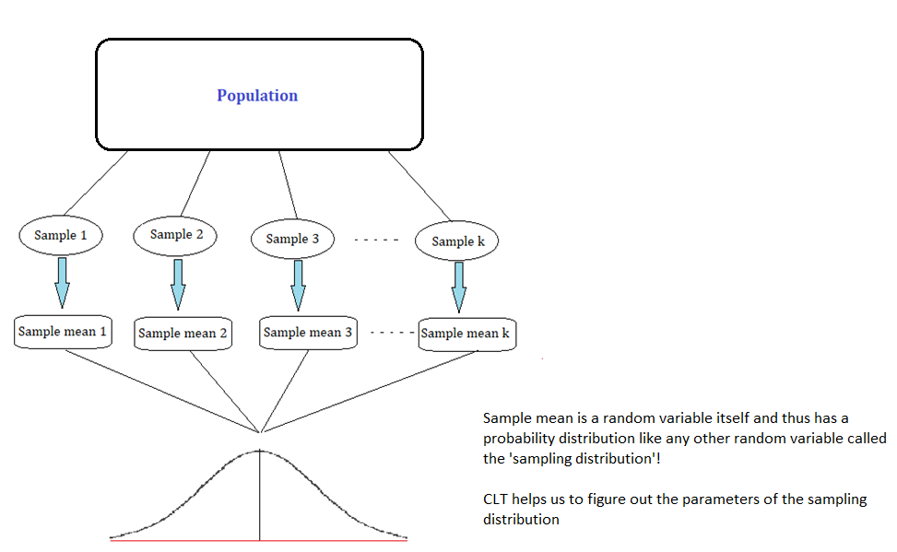
Central Limit Theorem (CLT) Visualized

Slide 62
Use of CLT
Based on the sample mean, we can make inferences about the population parameters, subject to certain conditions
Allows us to make probabilistic statements about sample statistics, even when the population distribution is not known, or is not normally distributed
Hypothesis testing usually relies on assumptions made about the distribution of sample statistics
Since CLT establishes normality of the sampling distribution of the mean, we can use tests such as t-test, z-test, which are applicable on normal distribution

